Slide 1

Work-Based Learning Program
Connecting students ages 16+ to work based learning job opportunities.

Slide 2

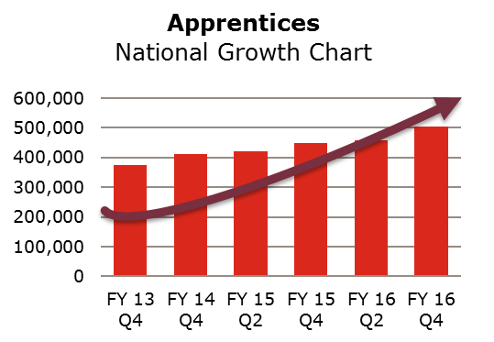
Work-Based Learning Renaissance
Across the U.S. and Ohio we are seeing a resurgence of work-based learning opportunities such as apprenticeship and high school cooperatives as a response to the skills gap.
Notes:
We are seeing youth apprenticeship and youth employment models growing tremendously all across the U.S. Why? Because it is a response to the skills gap.

Slide 3
What is the Skills Gap?
THE SKILLS GAP LANDSCAPE
The skills gap is a perceived mismatch between the needs of employers for skilled talent and the skills possessed by the available workforce.
Below is the skills gap landscape…
Unemployment rate
4.1%
Americans
unemployed
6.7 Million
More than
5.8 million jobs
are going unfilled
Only 6 out of 10
working-age individuals are employed or seeking a job
Source: American Staffing Association
Notes:
This was a powerpoint presentation delivered by American Staffing Association via webex October, 2017
As the economy rebounds from the Great Recession, a unique challenge has arisen. Businesses are struggling to find employees with what they perceive to be the necessary experience, skills, and training to fill open positions. Many believe this is one of the main reasons that the U.S. economy has not reached its full potential.
The issue becomes even more complex when considering the fact that a number of job seekers are not prepared to fill many of the higher-skilled jobs currently open.
If it hasn’t already, the skills gap could, and is quite likely to, negatively impact your business and the local economy.
The skills gap will widen as the economy strengthens and unemployment continues to fall.
Today, 7.1 million people are actively looking for work, while 6.2 million jobs are going unfilled.
Only six out of 10 working-age individuals are currently employed or even seeking a job.
[Updated 09/12/2017]

Slide 4

Job Openings
Job openings reach highest level since December 2000, exceeding hires.
Source: Bureau of Labor Statistics
Note: Data series began in December 2000
Notes:
This is a very interesting graph. In 2015 there was a switch… and now we see more job openings than hires being made.
Job openings are considered a lagging indicator of the economy given that businesses usually wait on reassurances of economic wellbeing before they choose to hire. Hires, on the other hand, are an indicator of the robustness of the labor force. U.S. Bureau of Labor Statistics started calculating these two metrics in December 2000. Historically, the two data series moved in the same direction, although hires outpaced openings.
The diversion from the trend began in early 2015 as the two measures stopped moving in the same direction and the number of job openings started to exceed the number of hires. Since January 2015, employers have added more jobs than they have added hires in the 29 of the last 31 months. The fact that there are more unfilled jobs than there are hires speaks to a large and growing need for qualified talent in the U.S.
In July 2017, the number of job openings totaled 6.2 million—the highest number since the inception of the metric—while hires amounted to 5.5 million. The last two years have recorded the greatest number of job openings since reporting of the metric began in 2000.
Difficulties in filling positions due to the skills gap have kept jobs open anywhere from 10 to 56 working days depending on the industry.
As of June 2017, the average U.S. job across all industries took 30 working days to fill, equivalent to the 2016 average.
The United States tops the world’s 12 major economies in the number of jobs still open after 60 days, as a combination of low wages and a lack of skilled workers have left many jobs unfilled (Indeed Hiring Lab, 2016).
[Updated 09/12/2017]
Job Openings: Total Nonfarm. Source: US. Bureau of Labor Statistics. Release: Job Openings and Labor Turnover (JOLTS)

Slide 5

Why is There a Skills Gap?
Training
Lack of on-the-job training
Skills
Gap
Preparation
Students are not being properly prepared for the real world of work
Expectations
Unrealistic expectations of job applicant training and experience
Talent
Shortage of skilled talent
Technology
New technologies requiring specific new skills
Wages
Wages are insufficient to attract specialized talent
Source: American Staffing Association
Notes:
This is what the American Staffing Association says has caused the skills gap.
___
What is driving the widening of the skills gap in this country?
Many employers perceive a significant gap in the skills they need at their organizations and the skills job seekers possess, leaving positions open, awaiting qualified candidates.
Wages in many industries have stagnated, and many employers have not been willing to offer more competitive salaries to attract the specialized talent they need.
As new technologies have emerged and been adopted in the workplace, the skills of job seekers have not kept up. Most of these skills are also harder for employers to measure and manage.
Employers also often have unrealistic expectations of the skills that job applicants should bring to the table, often not considering the cost benefit of hiring a candidate otherwise qualified and providing necessary training for specialized skills. On the other hand, students entering the workforce may not have the necessary skills needed to succeed in a competitive job environment.
To build a workforce that meets the needs of 21st century jobs, much more must be done to educate and train our youth and adult workforce to fill the voids in specific occupations.
[Updated 1/12/2017]

Slide 6
Skills Gap Drivers
Drivers
Unemployment
Education
Work Readiness
U.S. youth unemployment is more than double the national unemployment rate
10,000 baby boomers retiring each day
  19% of students in Ohio do not graduate high school
  College Degree: only 20% of Ohioans attain a bachelor’s degree
    Nearly 50% of college grads say they wish they had a different major
    Even fewer say college prepared them for a career
    “Signaling” that someone is capable but employers know they still need training.
    Ohio has an above average college student loan default rate
  Lack of exposure to professions / industries
    Partly due to a push toward academics and college for many years
    Perception of College vs. Apprenticeship
Businesses in Ohio and cannot find people with the right skills
Employers identify these primary barriers to entry-level jobs
  “Lack of Experience”
  “Lack of soft / essential skills”
  “Lack of education”
Decline of common pathways to skilled jobs
  Family Support
  Mentorship
  Apprenticeship
Notes:
At Adecco we recognize some other drivers.
Youth unemployment rate is more than double the national unemployment rate. Research shows us that those who got jobs in their youth are exponentially more likely to gain upward mobility by an average of 2 levels.
10,000 baby boomers retiring each day
EDUCATION:
19% of students don’t graduate high school.
College Degrees aren’t the answer…
40% who go to college don’t finish.
50% of college grads say they wish they had gotten a different major
Even fewer say college prepared them for a career
Employers say that a College Degree is a means of “signaling” that someone is capable of learning. But they still need a lot of training.
Defaults on college loans… so they can’t find a job with high enough wages to pay off their student loans
National Student Loan Debt = $1.4 trillion. This is a looming crisis.
Lack of exposure and the negative perception of in-demand skilled trades
WORK READINESS:
Employers say that a “lack of experience” is the main barrier to hiring people. It’s not education. This is because employers inherently understand the definition of a skill. Someone has a skill when they perform a task or job successfully over time. It is the practice or application of knowledge that is needed.
The second barrier are “essential skills” and even these need to be practiced.
Third is a “lack of education” but employers are requesting professional certifications more and more.
This last part is interesting. Our research has lead us to understand how people have gotten into a skilled job or trade. Someone who is an Electrician right now likely got there through 1 of these 3 ways.
Family Support – follow your family footsteps
Mentorship – someone you know from the YMCA or your church got you into that job
Apprenticeship – because the fabric of the first 2 are deteriorating in our society then companies can no longer rely on them like decades past. Apprenticeship or work-based learning is alive and growing.

Slide 7
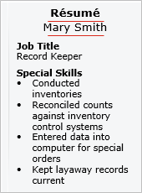
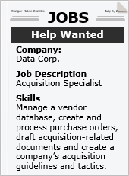
Trending Solutions to the Skills Gap
Consider the long-term unemployed
Look beyond job titles on résumés
Set realistic expectations on job descriptions
Hire for potential—
and provide training
Set pay rates based on talent supply and demand
Relocate in order to “follow the talent”
Source: CareerBuilder
Notes:
But, who would you offer Apprenticeship to? Who would you attract into Work-Based Learning?
Here are the recommendations according to conventional wisdom and recruitment trends:
– Expand your sources to almost anyone
– Water down your job descriptions so you don’t scare people away
– Develop a training program that can take anyone and train them into who you they could be
– Pay more money to attract away from your competitors
These could be great tactics! And the skills gaps is forcing us to do this.
There is a company in Pikeville, KY in coal country that is transforming old Coal Workers into Software Coders. It is an amazing endeavor… but without a really strong and transformational training plan that is impossible for many companies.

Slide 8

Desperate Need for
Work-Based Learning
Notes:
This is why we see a desperate need for Work-Based Learning.

Slide 9

Desperate Need for Work-Based Learning
THE MANUFACTURING TALENT GAP IS GROWING
According to the Manufacturing Institute, 3.4 million manufacturing jobs are expected to become available over the next 10 years, yet 2 million of those jobs may be unfilled if America stays on its current course.
“The issue that has concerned many for decades has finally reached a boiling point,” a report by Deloitte Consulting LLP and the Manufacturing Institute said. “The United States must find and develop people to address the talent shortage, or risk facing another wave of offshoring to places where talent is in greatest supply.”
Although the unemployment rate is less than 4.5% today, there are still 9.3 million Americans unemployed and 4.8 million vacant jobs because businesses are struggling to find workers with the skills to operate new machines and manage new processes.
One reason for this imbalance in the supply and demand of manufacturing talent is that too many job seekers, including college graduates, are graduating from school without marketable skills or any practical work experience. The automation of traditional “knowledge jobs” will only exaggerate this gap.
One of the best ways to close this skills gap is through work-based learning programs: paid training programs that combine on-the-job training and classroom instruction.
Adecco has pledged to facilitate 10,000 work-based learning opportunities by 2020. We are working hard to facilitate collaboration with policymakers, business leaders, nonprofits and educators to provide work-based learning solutions to prepare students for the future of work in America.
Source: Adecco
Notes:
This is our case study and we continue to update it. So you don’t have to read all this… just know we are doing the research and involved in the conversation across the nation.
___
Skilled baby boomers are retiring and millennials are not getting the skills they need to advance into these jobs. There are many well-paying jobs that require more than a high school diploma, but less than a four-year college degree.
One of the best ways to meet this potential shortage is through work-based learning programs: paid training programs that combine on-the-job training and classroom instruction.
We have pledged to facilitate 10,000 work-based learning opportunities by 2020. In order to meet our goal, we’ve encouraged federal, state and local officials to adopt policies and practices that promote work-based learning opportunities. Adecco is working hard to facilitate collaboration with policymakers, business leaders, nonprofits and educators to provide work-based learning solutions to prepare students for the future of work in America.
Speaking Notes: Update on Apprenticeship Initiative in U.S. (from the Wall Street Journal article on 6/12/2017)
In June, during “Workforce Development Week“, President Trump signed an executive order to significantly increase the number of U.S. apprenticeships from the current 500,000 by doubling the amount the government spends on apprenticeship programs.
Apprenticeship programs are most successful when they’re designed by employers around their own needs. For that reason, employers will play a strong role in the composition of the plan through a task force that Trump announced in June.
The aim is to fill a record level of open jobs and attract Americans who have left the workforce. Apprenticeships are an underused form of workforce training in the U.S. compared with European countries and have a proven record of good outcomes for workers, administration officials said.
There were more than 505,000 apprentices in training in fiscal year 2016, the U.S. Department of Labor said, the highest level on record since late 2000. Of the more than 8,000 active apprenticeship programs registered with DOL, almost half are in the construction industry and 20% are in manufacturing. Nine in 10 Americans who complete apprentice training land a job, and their average starting salary is $60,000 a year.
Companies creating apprenticeships that were included in the SHRM article:
The Hartford
Aon
Zurich North America
CVS Health

Slide 10

What is Work-Based Learning?
On-The-Job Training
Hands-on work experience
Within a program that has more controls and parameters
On-site at a business
Related Technical Instruction
Classroom style learning
Online Learning
Training Progression
High School Classes
Post-Secondary Classes
  A Proven Training Module
  A tangible and transformative learning experience
  An effective training model
  Affects increased loyalty
  Affects lower turnover
  Affects a learning culture
  Apprenticeship as the gold standard
Notes:
Here is a quick definition.
It is On-The-Job Work and Training + Related Technical Instruction
As a Proven Training Model this brings a lot of benefits to the organization too!
So what this is… is partnership. Businesses partnering with Educators to develop the workforce you need!

Slide 11

Ohio
The Adecco Group signs Memorandum of Understanding
with the Ohio Department of Education. Plans
to bridge
skills gap through work-based learning models.
The Adecco Group has executed a Memorandum of Understanding with the Ohio Department of Education, partnering with the state in on-the-job training efforts aimed at strengthening Ohio’s labor market.
The announcement follows The Adecco Group’s successful work-based learning partnership with the state of Kentucky.
The partnership supports Ohio’s New Skills for Youth grant and will build on the state’s Success Bound program, an initiative that is providing career readiness resources to students.
The Adecco Group is not only a resource to employers interested in exploring work-based learning options but also can act as the liaison between employers and other stakeholders, such as educators, ensuring that all requirements are met in order to activate work-based learning at a job site.
Notes:
Adecco has signed an Agreement with the Ohio Department of Education. We are an official partner with them to help get more of their students into work-based learning opportunities. So we are working on some high level initiatives including the New Skills for Youth and the SuccessBound initiatives.
Speaking notes: With a network of skilled recruiters and knowledge of Ohio’s employment landscape, as well as <<CLIENTNAME>>’s, Adecco is positioned to help <<CLIENTNAME>> take your existing program to the next level or create a new avenue of recruitment independent of your current program.
Announced on July 25, 2017
YES! Program Success Quote and Speaking Notes: “Our senior leaders see co-ops as one of the most effective ways to address employment gaps,” said Holly Brady, assistant manager of human resources at Toyotomi, a Toyota supplier that was an early adopter of The Adecco Group’s Kentucky program. “They’ve allowed us to engage with young talent that we otherwise wouldn’t have access to. Each student we work with learns the skills needed to be successful at our business, and we see them as potential full-time employees.”
The Adecco Group has seen firsthand how on-the-job training can transform a community. The company partners with Kentucky’s Department of Education and area businesses on a program geared at developing the state’s talent pool. In its third year, 81 percent of students who have completed the program have gone on to continue their education, extend their time in the program or receive a full-time job offers.

Slide 12

Our Role

Slide 13

Adecco Powers Work-Based Learning Programs
We are bridging the gap
Child Labor Laws
Hazardous Occupations
  Exemptions for “Student learner or apprentice”
YES! helps businesses define the scope of work and create the program.
  Within Department of Labor child labor regulations, OSHA, wage and hour laws, etc.
  Job Description
  Safety Walk-Through
Workers Compensation Insurance
Adecco is the employer of record
We employ and pay the students
We keep track of hours and other information requested by the Department of Labor
We take on workers’ compensation
Traditional staffing agency relationship with Adecco
Bridging the Gap
Businesses have two barriers to offering youth employment
Notes:
This is why we are a valuable partner. This is why we are needed.
Businesses have 2 barriers to hiring youth: Child Labor Laws and Workers Comp Insurance.
Workers Comp – Your Workers Compensation Insurance carrier will not allow you to hire underage. Or it may just be too expensive. Adecco becomes the employer of record so we take on workers comp insurance, paying the students, payroll taxes, etc.
Child Labor Laws prohibit people underage from working in “hazardous occupations.” However the Federal Law states exemptions for “bonafide student learners or apprentices.” So we provide the expertise to help a business walk through the laws, define what students can and cannot do, and put together a legal program.

Slide 14
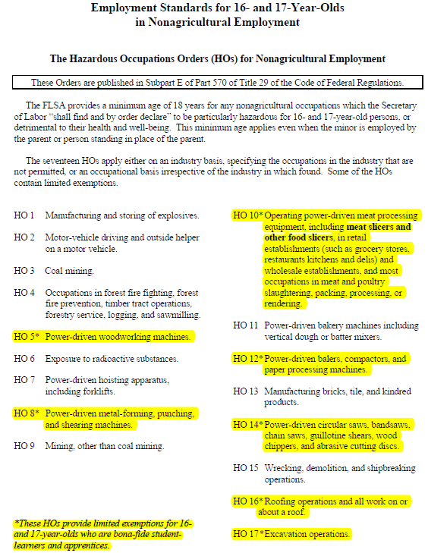
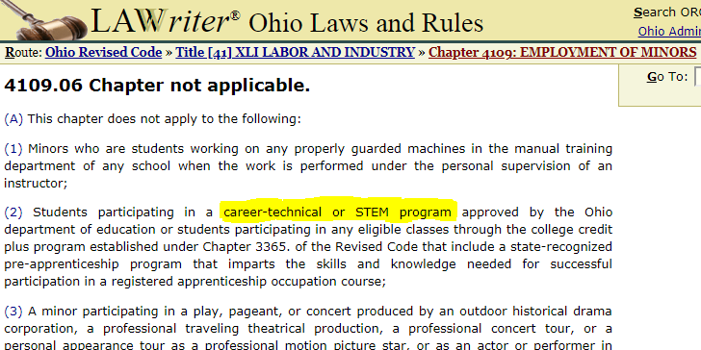
Child Labor Laws
Federal Law
Ohio Law
Source: http://codes.ohio.gov/orc/4109.06v1
Source: “Child Labor Bulletin 101”
Notes:
I have provided the Federal Child Labor Laws on the left and the Ohio Code on the right.
In Ohio everyone is familiar with this statement that “students participating in career-technical or STEM programs or college credit plus programs are exempt.” And this is awesome! Ohio is ahead of the game because it makes it very clear for employers and educators.
However, Ohio has just taken the Federal Law and made it clear for employers. The Federal Law is a foundation. And that Federal Law states
“exemptions for 16-17 year olds for bona-fide student learners and apprentices.”

Slide 15
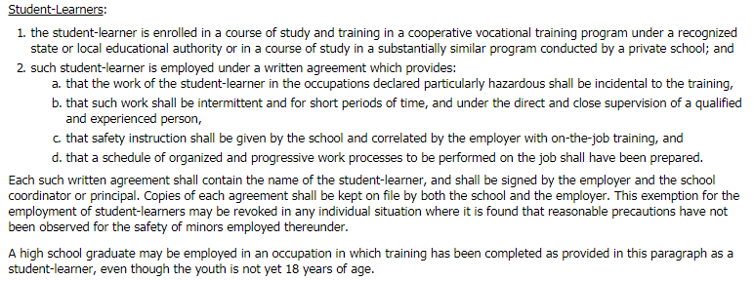
Federal definition of a “Student Learner”
Child Labor Laws
Source: https://www.dol.gov/whd/regs/compliance/childlabor101_text.htm#8
Notes:
So what is the definition of a student learner?
The state of Ohio has said that any student in a career-technical pathway or STEM program must be a bona-fide student learner. Federal law makes it clear that you don’t have to be in CTE to be a bona-fide student learner or apprentice.
There are 2 things needed to ensure a bona-fide student learner:
“The student learner is enrolled in a cooperative vocational training program or a course of study that is substantially similar” Again it does not use the terminology “CTE.”
“The student-learner is employed under a written agreement.” For this reason Dept of Education created the WBL Training Plan / Training Agreement.

Slide 16
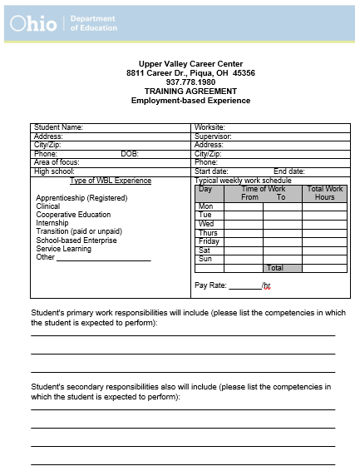
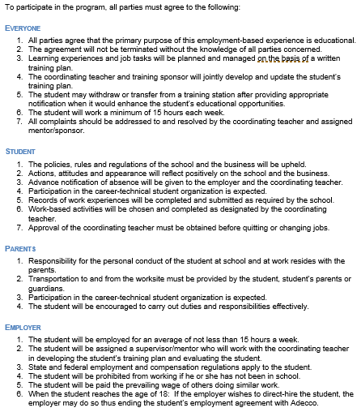
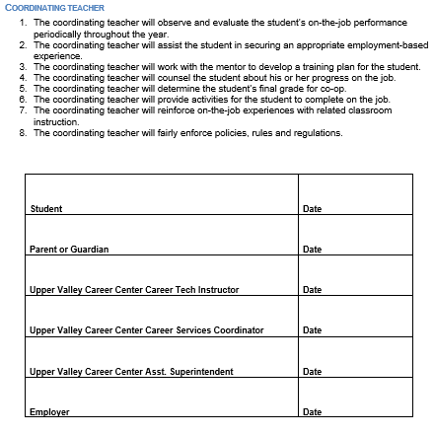
WBL Training Agreement
Notes:
This is that WBL Training Agreement.
This is a copy of one that Upper Valley Career Center with Adecco in mind. If you want to replicate this one I can send it to you.
The Teacher or Internship Coordinator fills this out. It includes the students info, their work schedule, their work responsibilities, and the competencies they are expected to learn on the job. These competencies should match up in some way to the things they would learn in the classroom.
This document establishes the relationships and accountabilities between all of the parties involved.
Then the Teacher signs it, Student signs it, Parent signs it, and the Employer/Business signs it.
Again, all career pathways and programs can prepare students for careers. The WBL Plan (the Teacher drafted document) is key to attaching the students related technical instruction to the job and work related duties.

Slide 17

Career Pathways and Occupations
Career Centers/CTE
Industrial Maintenance
Electricity
Welding
Tool and Die Technician
Machinists
Motor Winder/Repair
Engineering
Supply Chain and Logistics
Injection Molding Technician
Carpentry
Auto Mechanics
Pre Nursing Healthcare
Business
Marketing
Accounting and Finance
Traditional High Schools
Quality Control
Inspection
Operators
Assembly
Warehouse
Pick/Pack
Inventory Control
Supply Chain & Logistics
Financial Services
Marketing
Customer Service
Healthcare Support
Different jobs for different students
Where would it make sense for a business to create a bottom-up talent pipeline?
Notes:
However, not all students will be prepared to take on just any internship/apprenticeship opportunity. We still cannot place students into jobs without a proper training… especially in the skilled trades.
If a company wants to offer an Industrial Maintenance Co-Op position then we would still have to attract students from a Career Center or CTE pathway.
However, there are more entry level jobs within “hazardous occupation” job sites that would provide a great start for Traditional School students. The same companies who are partnering with Career Centers for Welding students should consider partnering with their local Traditional School for Quality Inspectors, Inventory Control, Supply Chain, etc.
Meanwhile there are many companies out there who haven’t partnered in this way yet and you may be interested in partnering with both.

Slide 18

Why a High School
Recruitment Program?
Notes:
As an employer you might be saying “Okay… I understand now that it might be legal to do…. But why would I? Why would I have a high school recruitment program?

Slide 19
Why Have a High School Pipeline?
Four Reasons:
Access to a
Talent Pipeline
High schools as originating source of talent
Career Pathways
and Preparation
Ohio high school students choose career pathways, Career-Technical Education (CTE) programs, JAG classes, Career-Based Learning, and other preparation classes or associations
We help you identify students in pathways and other classes that correlate to your position needs
This provides an excellent educational foundation of knowledge to build upon
Students have interest in pursuing this as a career
Learning Agreement/
Work-Based Learning Plan
A teacher-drafted document
Curriculum + job description
Goals for the student
Teacher, student, parent, and employer will sign it
Apprenticeship ties into this seamlessly
Work Ready and
Soft Skills
Job coaching support from educators
Accountability for trainees while still in school
Adecco Soft Skills Package
OhioMeansJobs (OMJ) Readiness Seal
Notes:
Well let me give you 4 great reasons.
High schools are your originating source for talent. If you were to take every resume from every employee in your company… flip to the bottom of those resumes… and you will find a high school. But for some reason they went to work at 2-3 other places before you found them and hired them. And now you have train against all of the bad habits they picked up elsewhere. W
Well this tells us that the talent is there. The potential is there. You can identify, attract, and train them right now.
2. That talent pipeline is formidable! Prior to 2 minutes ago was anyone familiar with the term “career pathways”? This is the high school equivalent of choosing a major. Students are taking 4-5 classes in a field which means they are knowledgeable. And they choose their career pathway which means they have an interest in pursuing that field for a career.
3. The WBL Plan/Agreement. This is way more important than just covering the child labor laws. This gives every student a plan. It establishes their goals.
4. And then forth and most importantly… the WBL Plan/Agreement means that Teacher becomes a support for you. The Teacher becomes a Job Coach. This is very different from hiring people off the street because we know as well as anyone there is no accountability for people. Also, unfortunately people (youth especially) have to learn the hard way. Well having an accountability system in the form of a Teacher who cares for their students helps them overcome challenges people face when learning to transition into the workforce and into a career.
WBL is like a drivers license permitting process. To get a drivers license you have to ride along with someone over 25 for a period of time. Then they can take the test and have the opportunity to earn the ability to drive alone. We all know people who still freak out to drive in the snow, or a storm, or merging onto the interstate. In the workplace we all face sets of challenges. WBL puts a Teacher, employer, and Adecco in the passenger seats to help a student navigate through the obstacles on the road.
By the time they graduate they will be much more prepared to take on the full scope and responsibility of the job.

Slide 20

Say YES! With Adecco
THE BENEFITS
Youth Employability
  Students now have more work-based training and employability
  Advanced soft skills
  Job coaching and accountability
  Realistic expectations of the workplace
  Reigniting students’ inner drive and motivation
  Zero college debt
For Business
  Extend a consistent talent pipeline
  Identify and attract skilled students
  Fresh ideas
  Mentor and mentees
  Commitment level from students
  Increased loyalty and retention rates
  “Attraction Magnet” effect to grow your future talent pool
  Deepen your connection and ties to your community
  Via partnership have input into education
Education and Society
Ohio is closing the skills gap
Producing more graduates who are
work-ready
Keep local talent responds to “brain drain”
Expanding and upskilling the workforce
Notes:
There are many other benefits for youth in Work-Based Learning. For many of them they will be life-changing opportunities. For some we are talking about generational change and impact.
For Education and Society:
We are all a part of something greater than ourselves.
If you live or work in a rural area then you will understand the “brain drain.”
For Business:
80% likelihood you will make a full-time offer to the student at graduation.
Most importantly you are investing into the value of your own organization. What do I mean by that? [next slide]

Slide 21
Apprenticeship vs. Traditional Learning
A CONCEPTUAL MODEL FOR EXPERTISE DEVELOPMENT
Apprenticeship Model
Education with Business
Experience Synergy
EXPERTISE
Education + Experience
Experience
Education with Experience
Traditional Model
Education Followed by
Business Experience
Education
1
2
3
TIME
(Years)
Source: Department of Labor Employment and Training Administration
Notes:
Here is a model that explains the value of work based learning for the employee. It demonstrates the ability of someone to gain greater expertise in a shorter amount of time. A work-based learning model outperforms the traditional model of study only to get a degree, and then go to work.
Greater expertise = greater pay… but that also = greater value = more ability for a company to reach it’s goals for their customers.
In this way you take control of increasing the capabilities of your workforce and your organization. You get involved in developing talent.
As we at Adecco take part in thought leadership conferences we are consistently explaining “that businesses should be taking on the role of being producers of talent and not consumers of talent only.”
That opportunity exists. Educators are ready for it. During this conference Educators are working to implement programs and structures and best practices internally that will support their students and businesses who want to partner. So the timing is excellent!
Department of Labor Employment and Training Administration
https://www.doleta.gov/OA/apprenticeship.cfm

Slide 22
Our Role
Notes:
So our role is to help businesses and schools see the value in Work-Based Learning and help you develop programs that will gain those intended benefits.

Slide 23

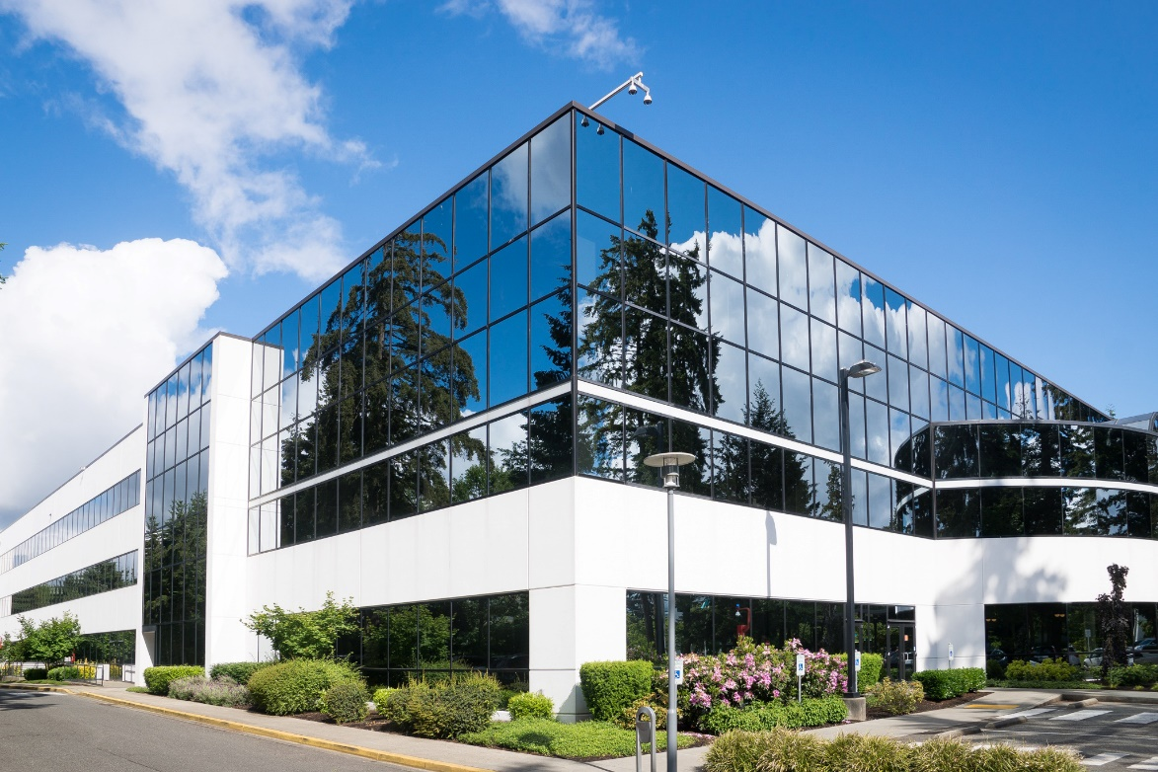
Partnership Overview
Memorandum of Understanding (MOU) with Department of Education
Payrolling Services Agreement with Businesses
Work-Based Learning Services Agreement
with Schools
Work-Based Learning Training Plan
Notes:
If we take a 30,000 foot view… this is the overview of what the relationships look like. I picture it like a triangle. There are 3 parties involved. And between each of the parties there are 3 separate agreements that get signed.
All of which have been designed around the WBL Training Agreement. So the language of the agreements mirror and refer to each other.

Slide 24

How We Help Schools
Outreach to Businesses
Connect to third party partners (chamber, job centers, etc.) for outreach
BEST PRACTICE: School open house
BEST PRACTICE: Luncheon presentation
Normal outreach process
Events and Initiatives
Success Bound conferences
Manufacturing day Project-Based Learning (PBL)
Soft Skills courses for students
Promote the OhioMeansJobs (OMJ) Readiness Seal
Promote Registered Apprenticeship
Preparing Businesses for Partnership
Expertise to help businesses create safe programs that schools will want to partner with
Walk through legal, liability, documentation and other issues with businesses
Explain work-based learning plans
Explain registered apprenticeship

Slide 25

How We Help Businesses
Program Creation
Site Safety Process
  Walk through the site and view OSHA 300 logs
  Safety limitations
  Child labor laws
  Develop job descriptions
  Obtain documented training sign-offs
Introductions to Educators
Communication to school leadership
Expertise to target and attract the right students
BEST PRACTICE: Open house
Get commitment from education on how they will partner to provide the talent requested.
Payroll for Students
Onboarding
Bank account set-up
Payroll/PeopleNet
Any Department of Labor time keeping needs

Slide 26

References and Articles

Slide 27

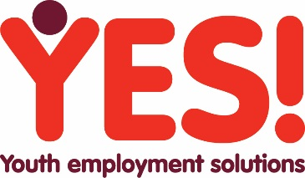
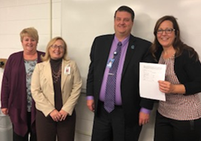
Ohio Program Contracts Signed
HONDA in Marysville
The Adecco Group has partnered with the Ohio Department of Education through its Success Bound initiative designed to bridge the skills gap through work-based learning models.
Honda is a major employer in Ohio located in Marysville. After some initial meetings, digging into their skills gap analysis, and their scheduled retirement trends they recognized the need to attract high school students into their skilled trades positions.
We are starting with one student in a Pre Engineering position as a pilot. If successful the program will extend into Industrial Maintenance and other departments.
A high school Career Center that receives students from five different school systems. The Career Center focuses on Career Technical Education CTE programs that prepare students for immediate careers in dozens of trades and career fields.
They hosted an Open House and Q&A session for Honda at school property. They also connected Honda to the first potential student for interviews. Honda is excited about that student! Honda is also excited about a partnership with the school for support on job coaching selected students and also for developing a pipeline of talent.
Notes:
This is one way we are combating the skills gap…
Notes from Liane:
Ohio’s SuccessBound initiative aims to bring together schools, businesses and communities to help students find their passions and career paths, at the same time helping Ohio build a future workforce for businesses.
We attended the Success Bound conference in Columbus. I can get you information on that Monday. We already have great connections with our schools. We started doing job readiness courses at this particular school 3 years ago. Every year we go out and help their students with resume writing, interviewing, job search and just make sure that they understand the job market. That was probably an integral part to the success.

Slide 28

Ohio Partnerships
Cincinnati Public Schools + The Cincinnati USA Regional Chamber of Commerce + Adecco
The Adecco Group has partnered with the Ohio Department of Education through its Success Bound initiative designed to bridge the skills gap through work-based learning models. Cincinnati Public Schools and the Cincinnati Chamber of Commerce have partnered up to expand their “career-based learning” program within the traditional schools. They also conducted business outreach and achieved 6 manufacturers to sign on.
Career-Based Learning Program
Preparing students by infusing career readiness curriculum in the classroom.
Professionalism, critical thinking and problem solving
Communication, team work, and cultural competency
Ethics, actions, and accountability
Managing self
Preparing students by connecting them to work experiences with help from Adecco and the Chamber of Commerce:
Manufacturing Assembly Operations
Warehousing and Logistics Operations
Flexographic Printing Operator
Customer Project Manager
Notes:
This is one way we are combating the skills gap…
Notes from Liane:
Ohio’s SuccessBound initiative aims to bring together schools, businesses and communities to help students find their passions and career paths, at the same time helping Ohio build a future workforce for businesses.
We attended the Success Bound conference in Columbus. I can get you information on that Monday. We already have great connections with our schools. We started doing job readiness courses at this particular school 3 years ago. Every year we go out and help their students with resume writing, interviewing, job search and just make sure that they understand the job market. That was probably an integral part to the success.

Slide 29
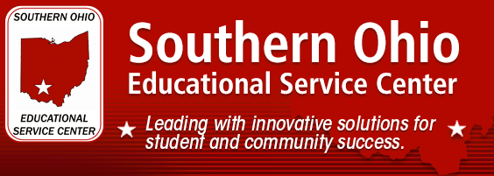
Ohio Partnerships
Wilmington, OH
The Southern Ohio Educational Service Center SOESC had received a grant to place students with disabilities into work-based learning job positions. Adecco partnered up with them and the Department of Education’s Office for Exceptional Children. Adecco and the SOESC performed a business outreach initiative. We identified 6 organizations willing and able to partner on this initiative.
Ohio Department of Education
Office For Exceptional Children
25 Students from school districts within the Southern Ohio Educational Service Center are currently working and engaged in work-based learning positions. Most students are engaged in a rotation which allows students to get work experience in multiple businesses.
Notes:
This is one way we are combating the skills gap…
Notes from Liane:
Ohio’s SuccessBound initiative aims to bring together schools, businesses and communities to help students find their passions and career paths, at the same time helping Ohio build a future workforce for businesses.
We attended the Success Bound conference in Columbus. I can get you information on that Monday. We already have great connections with our schools. We started doing job readiness courses at this particular school 3 years ago. Every year we go out and help their students with resume writing, interviewing, job search and just make sure that they understand the job market. That was probably an integral part to the success.

Slide 30

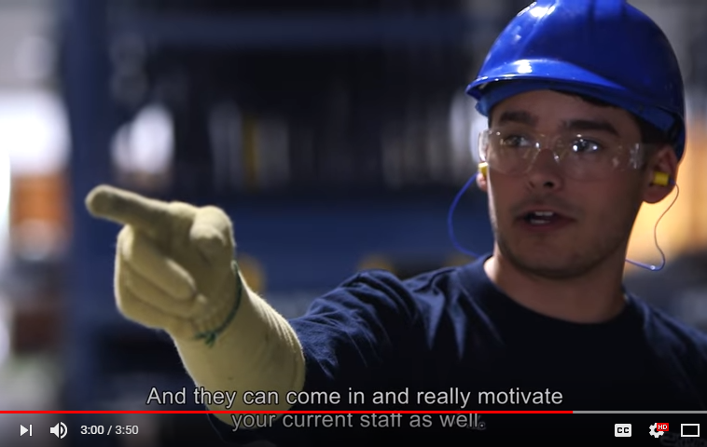
References and Articles
TOYOTOMI
Online at:
http://bit.ly/YES-Toyotomi-VideoTestimonial

Slide 31


